Slide 1
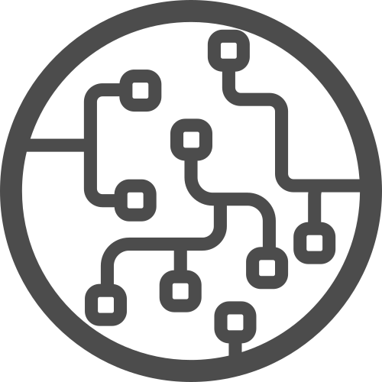




DAY-4
Introduction to Machine Learning & Regression

Slide 2



Instructor
From: Prodi Teknik Elektro, Institut Teknologi Bandung
Social Media:
Cynthia Evani
@cynthiaevani
Certification:
Google IT Automation with Python
Google Tensorflow Developer
AWS Certified Cloud Practitioner
Experience:
Machine Learning Student, Bangkit Academy (2021)
Machine Learning Engineer, PT Nomura Research Institute Indonesia (2021 - )
Cynthia Evani
DKI Jakarta

Slide 3
What is Machine Learning?
“the study of computer algorithms that can improve automatically through experience and by the use of data”

Slide 4
Comparison
Traditional programming
Rules
Traditional programming
Answers
Data
Machine learning
Answers
Machine learning
Rules
Data

Slide 5
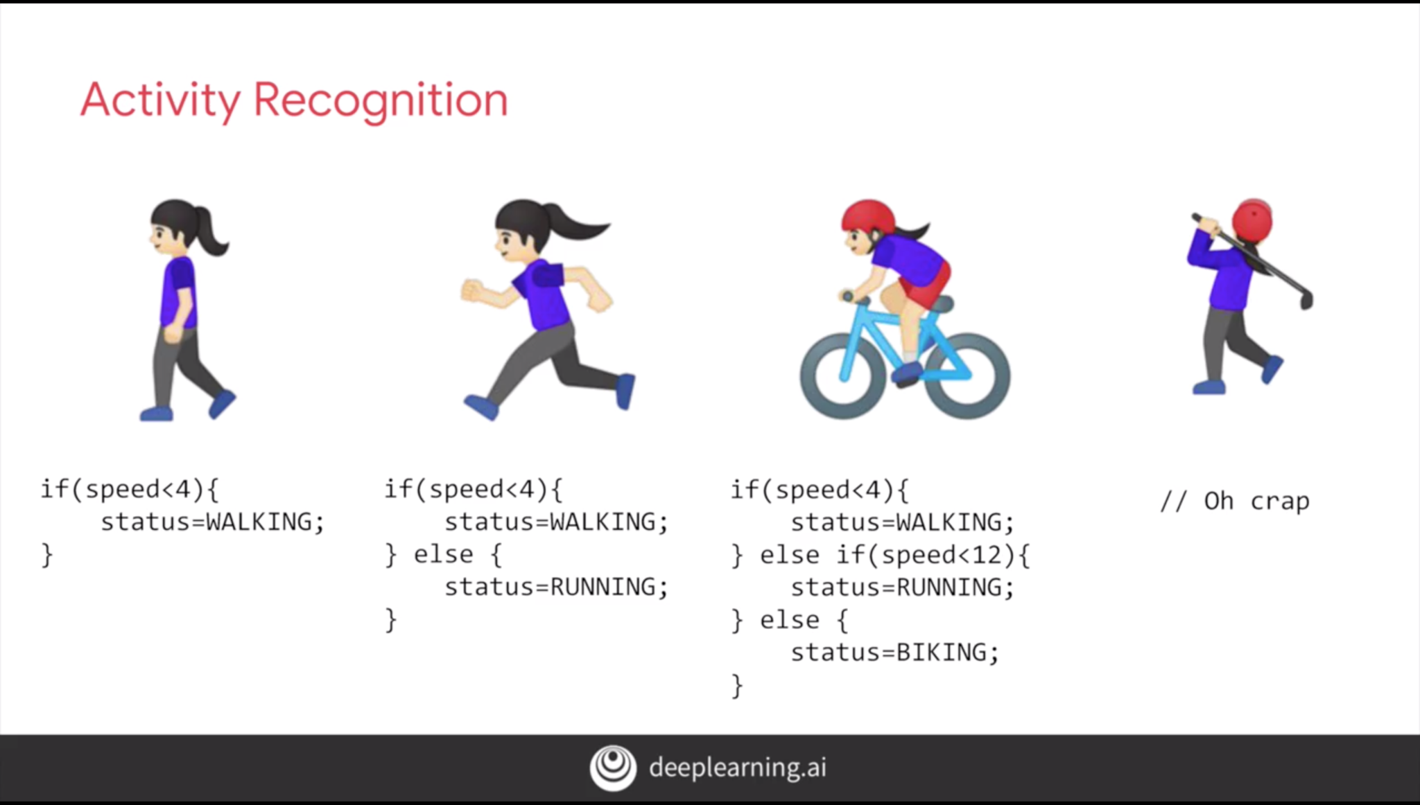
Traditional Programming

Slide 6
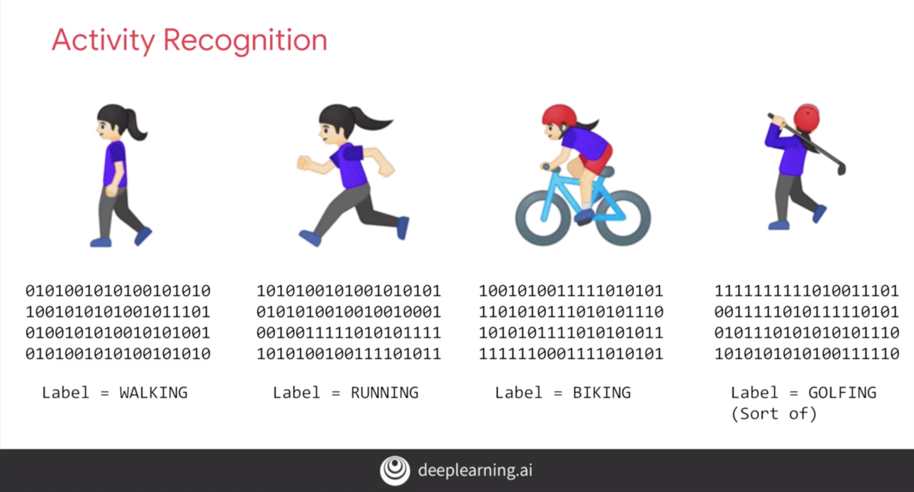
Machine Learning

Slide 7

AI vs ML vs DL
Artificial Intelligence:
a technology which enables a machine to simulate human behavior
Machine Learning:
a subset of AI which allows a machine to automatically learn from past data without programming explicitly
Deep Learning:
a subset of ML that structures algorithms in layers to create an "artificial neural network” that can learn and make intelligent decisions on its own.

Slide 8
The Need for ML
AI is still in its initial stage and haven’t surpassed human intelligence in many aspects.
Simply, the reason to make machines learn is to make decisions, based on data, with efficiency and scale.
Organizations are investing heavily in newer technologies like AI, ML, and DL to get the key information from data to perform several real-world tasks and solve problems.
Data-driven decisions taken by machines, particularly to automate the process so problems can be solved efficiently at large scale.

Slide 9
When to use ML
Lack of human expertise or resource
Example: navigations in unknown territories or spatial planets
Dynamic scenarios (the situation keeps changing over time)
Example: network connectivity and availability of infrastructure in an organization
Difficulty in translating expertise into computational tasks
Example: domains of speech recognition, cognitive tasks etc.

Slide 10
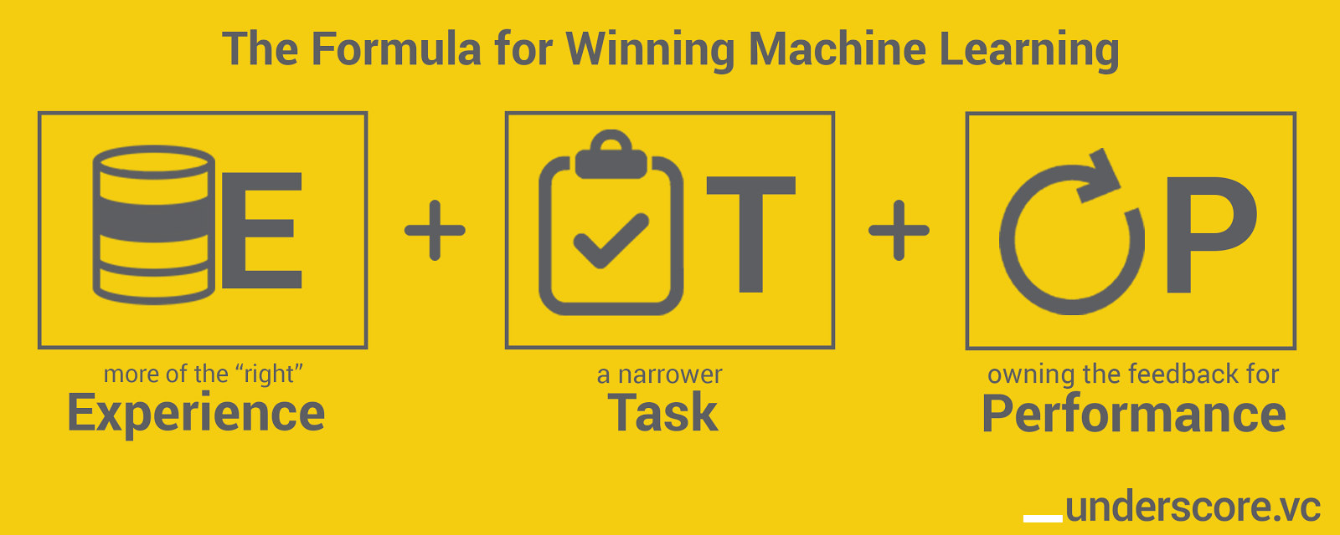
Performance, Task, Experience
ML is a field of AI consisting of learning algorithms that:
Improve their performance (P)
At some task (T)
Over time with experience (E)

Slide 11
Performance, Task, Experience
Task (T): the real-world problem to be solved.
ML based task is based on the process that the system must follow for operating on data points.
Example: regression, classification, clustering, etc.
Experience (E): the knowledge gained from data points provided to the algorithm or model (the learning).
Methods: supervised, unsupervised, reinforcement.
Performance (P): the quantitative measure which tells whether ML algorithm is performing as per expectation or not
Usually called metrics.
Example: accuracy score, F1 score, confusion matrix, precision, recall, sensitivity etc.

Slide 12
Real-World Applications of ML
Emotion analysis
Sentiment analysis
Error detection and prevention
Weather forecasting and prediction
Stock market analysis and forecasting
Speech synthesis
Speech recognition
Customer segmentation
Object recognition
Fraud detection
Fraud prevention
Recommendation of products to customer in online shopping

Slide 13
Challenges in ML
Data quality
Time-consuming task
Issue of overfitting and underfitting
Curse of dimensionality
Difficulty of deployment

Slide 14
Scope of Class

Slide 15
ML Learning Methods
Supervised Learning
Required: input data and corresponding labels.
Case: regression and classification.
Unsupervised Learning
Required: just input data.
Case: clustering and association.
Reinforcement Learning
Required: input data and reward feedback (reinforcement signal).
Case: navigation.

Slide 16
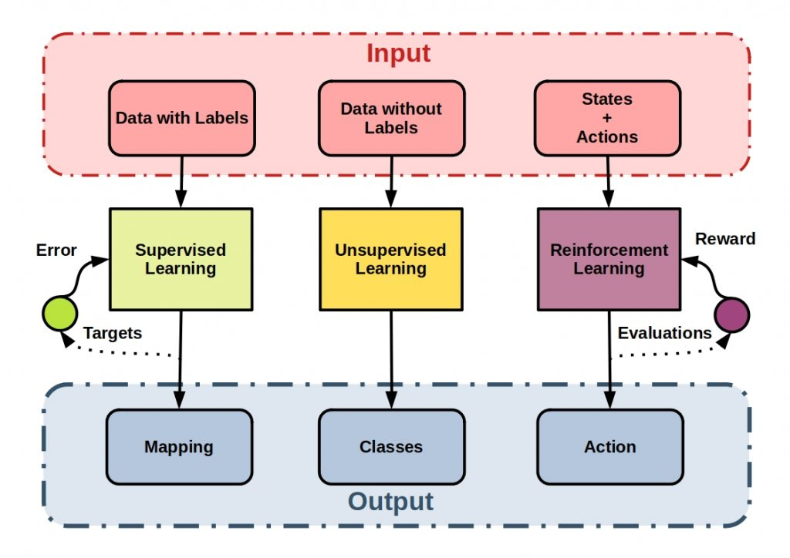
ML Learning Methods

Slide 17
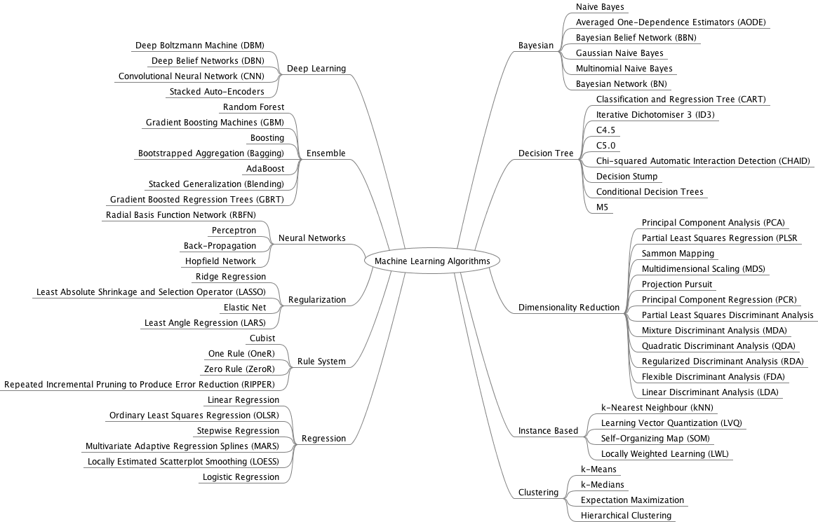
ML Algorithms
...it’s a lot

Slide 18
Scope of Class
We’re not going to learn every single algorithm on the previous slide.
We’re going to focus on supervised learning for the following cases:
Regression
Classification
Image Classification
The approach will mainly use neural networks (not statistical approach).
We’ll mainly use Tensorflow and scikit-learn.

Slide 19
ML Basics

Slide 20
Common Terms
A machine learning model is a file that has been trained to recognize certain types of patterns.
A dataset in machine learning is a collection of data pieces that can be treated by a computer as a single unit for analytic and prediction purposes.
Training is a process in which a machine learning (ML) algorithm is fed with sufficient training data to learn from.
Evaluation is the process through which we quantify the quality of a system's predictions.
Inference is the process of running actual data points into a machine learning algorithm to calculate an output.

Slide 21
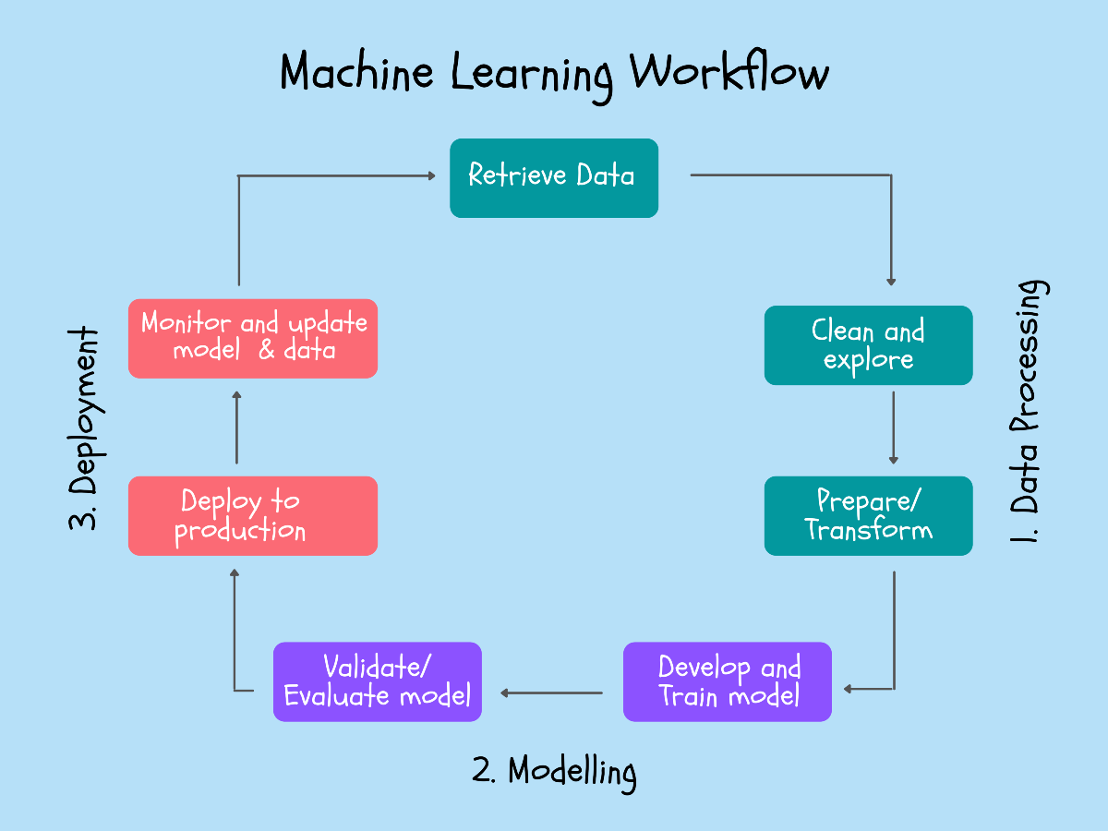
ML Workflow

Slide 22
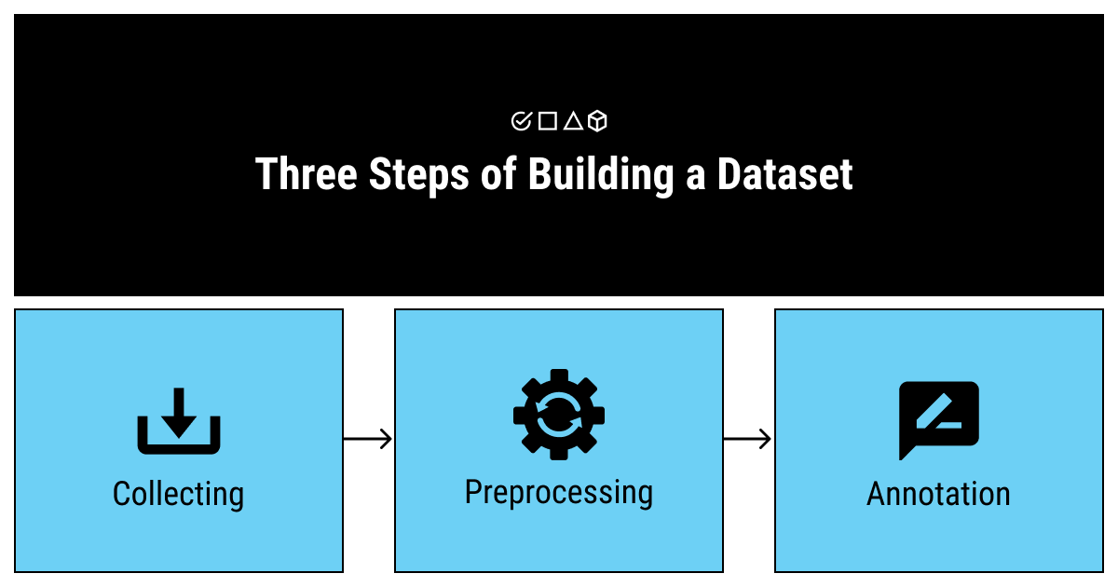
Dataset
Building a dataset

Slide 23
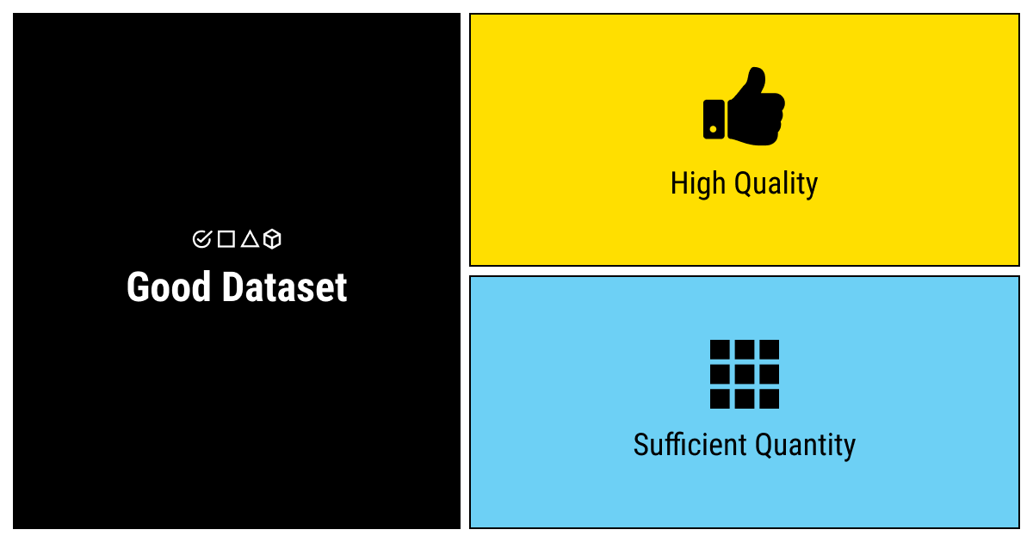
Dataset
Good dataset consists of:
Good quality: relevance and coverage
Sufficient quantity (need to have enough to train models properly)

Slide 24
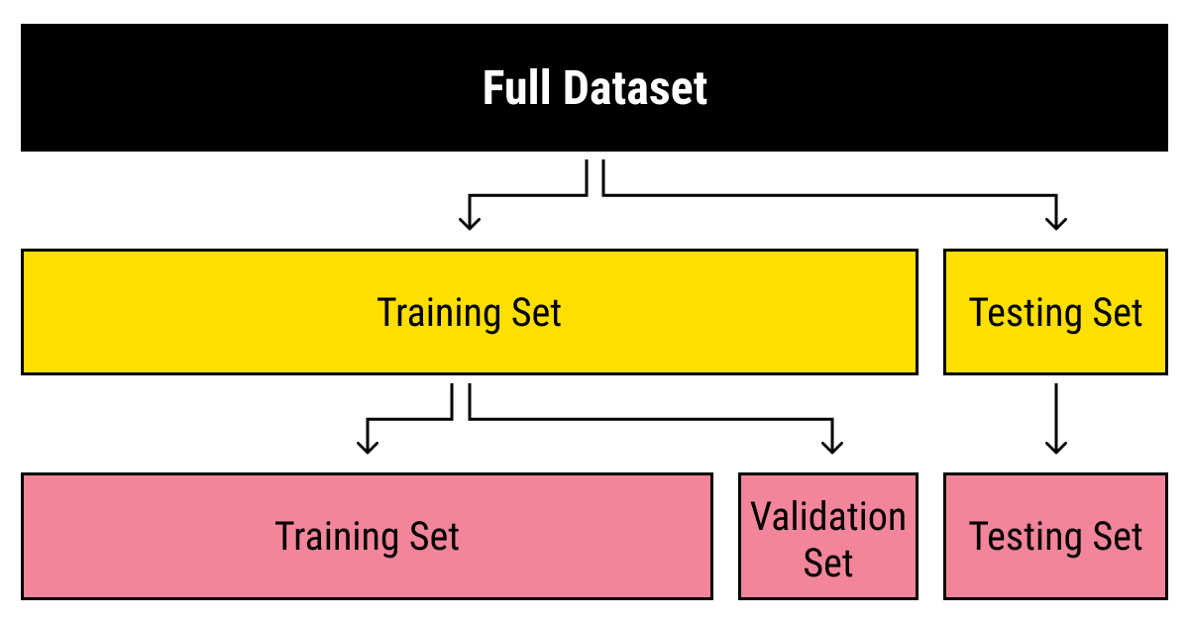
Dataset
Dataset is usually split into training set and testing set.
The ratio varies, but usually a good starting point is 80% training 20% testing.
Optional: Training set is further split into training and validation, again a good starting point is 80% training 20% validation.

Slide 25
Dataset
Training set:
The sample of data used to fit the model.
Validation set (optional):
The sample of data used to provide an unbiased evaluation of a model fit on the training dataset while tuning model hyperparameters. The evaluation becomes more biased as skill on the validation dataset is incorporated into the model configuration.
Testing set:
The sample of data used to provide an unbiased evaluation of a final model fit on the training dataset.

Slide 26
Parameter vs Hyperparameter
Parameter (internal value)
They are required by the model when making predictions.
They values define the skill of the model on your problem.
They are estimated or learned from data.
They are often not set manually by the practitioner.
They are often saved as part of the learned model.
Example: weight, coefficient, etc.
Hyperparameter (external value)
They are often used in processes to help estimate model parameters.
They are often specified by the practitioner.
They can often be set using heuristics.
They are often tuned for a given predictive modeling problem.
Example: split ratio, learning rate, epoch, etc.

Slide 27
Common Hyperparameters
Learning rate: determines the step size at each iteration while moving toward a minimum of a loss function.
Epoch: indicates the number of passes of the entire training dataset the machine learning algorithm has completed.
Batch size: the number of training examples utilized in one iteration.
Activation function: a function that is added into an artificial neural network in order to help the network learn complex patterns in the data.
Optimizer: a method or algorithm used to update weights and biases to reduce the error.
Loss function: the function that computes the distance between the current output of the algorithm and the expected output.

Slide 28
Math behind ML

Slide 29
The dreaded math behind ML
In order to understand some hyperparameters, we need to learn a bit about the math behind ML.

Slide 30
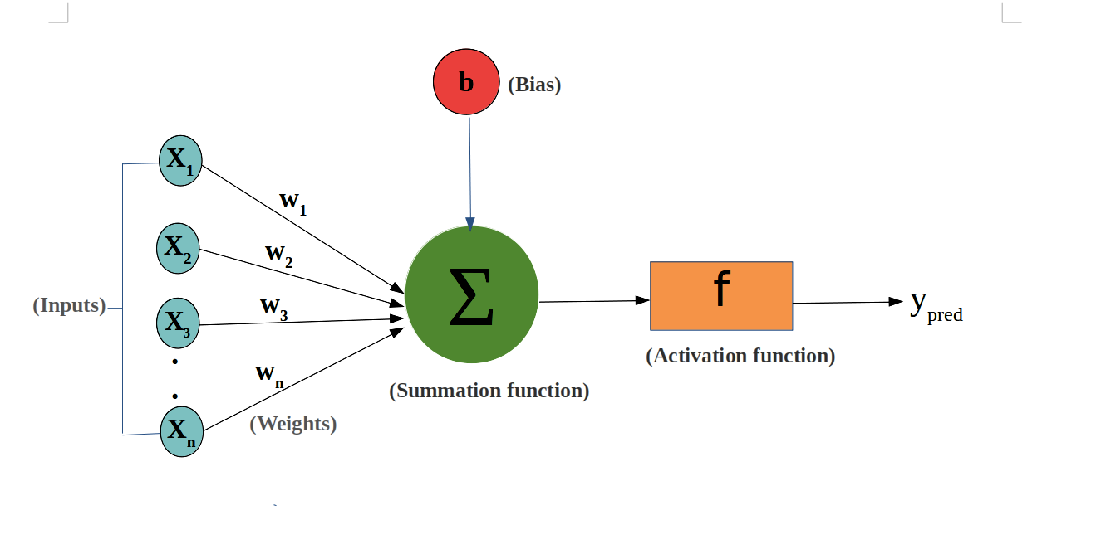
The Math behind ML
Artificial neuron is the basic building block of neural networks.

Slide 31
The Math behind ML
Components:
Inputs: the set of values for which we need to predict the output value (sometimes called features).
Weights: the real values that are associated with each feature which tells the importance of that feature in predicting the final value.
Bias: used for shifting the activation function towards left or right, it can be referred to as a y-intercept in the line equation.
Summation function: used to bind the weights and inputs together and find their sum.
Activation function: used to introduce non-linearity in the model.

Slide 32
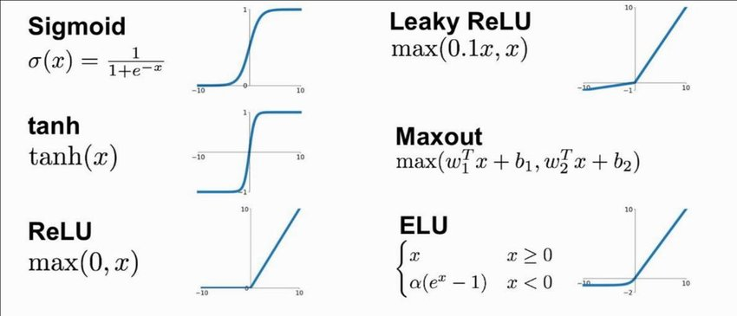
Activation Functions

Slide 33
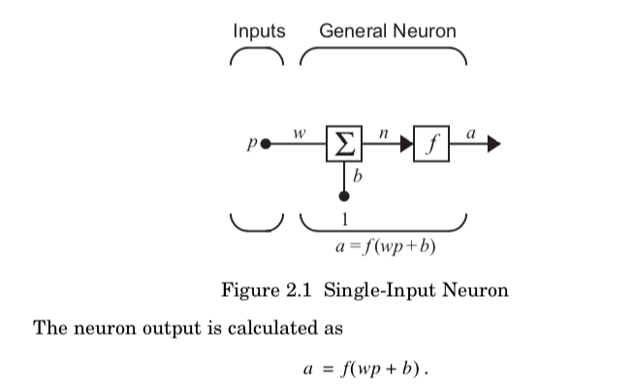
Calculating Neuron Output
Single-input neuron

Slide 34
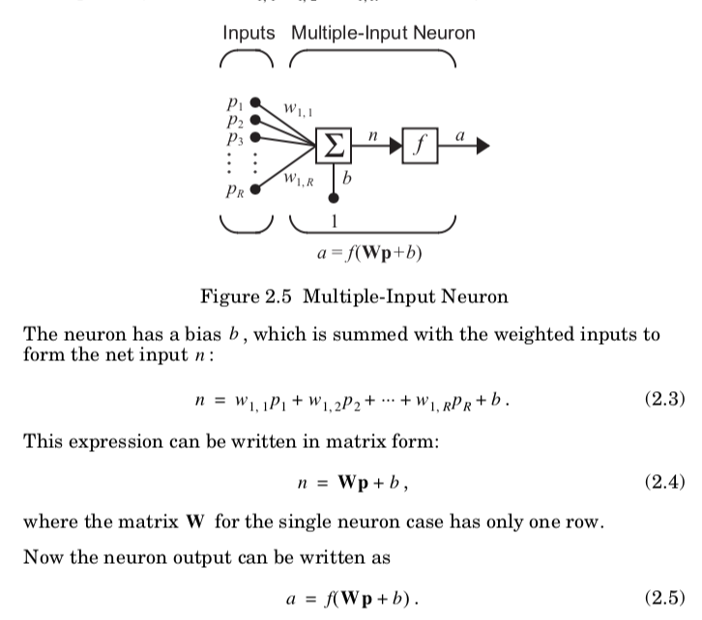
Calculating Neuron Output
Multiple-input neuron

Slide 35
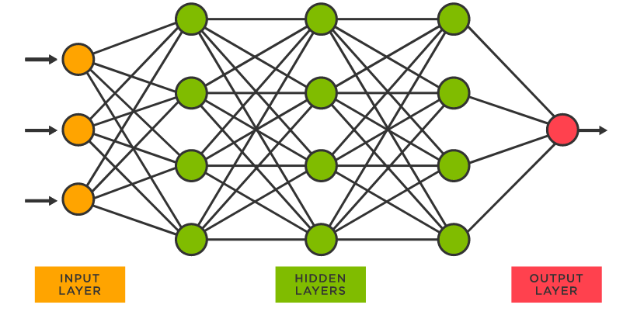
Deep neural network illustration

Slide 36
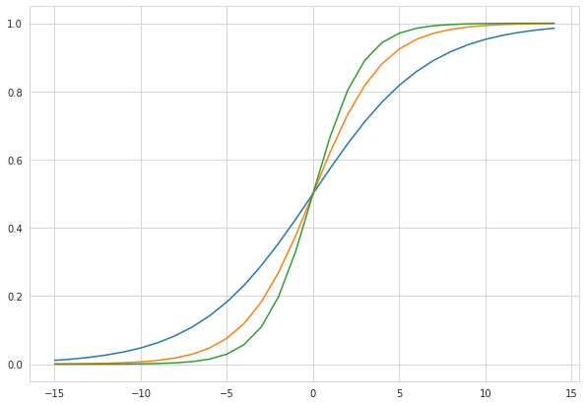
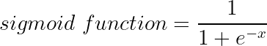
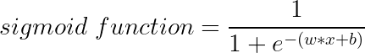
Effects of Varying Weights
Consider a sigmoid function
Replace x with linear equation
Set b = 0
w = 0.3 (blue line)
w = 0.5 (orange line)
w = 0.7 (green line)

Slide 37
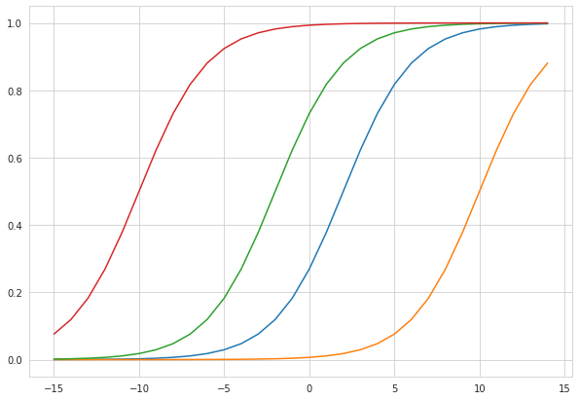
Effects of Varying Bias
Set w = 0.5
b = -1 (red line)
b = -5 (green line)
b = 1 (blue line)
b = 5 (yellow line)

Slide 38
More about Weights and Bias
Weights and bias are updated iteratively through the learning process.
The purpose of updating weights and bias is to have minimum loss (error).
How many times the weights and bias are updated relates to epoch and batch size.
Epoch: indicates the number of passes of the entire training dataset the machine learning algorithm has completed.
Batch size: he number of training examples utilized in one iteration.
Iterations is the number of batches needed to complete one epoch.
So if we have a dataset of 2000 examples and we set the batch size to 500 then it will take 4 iterations to complete 1 epoch.

Slide 39

More about Weights and Bias
The step size at which the weights and bias are updated relates to learning rate.
Learning rate: determines the step size at each iteration while moving toward a minimum of a loss function.

Slide 40
More about Weights and Bias
The method to update the weights and bias are updated relates to optimizer.
Loss function: a method or algorithm used to update weights and biases to reduce the error.
In general, Adam is the best optimizer. Another good alternative is SGD and RMSProp.

Slide 41
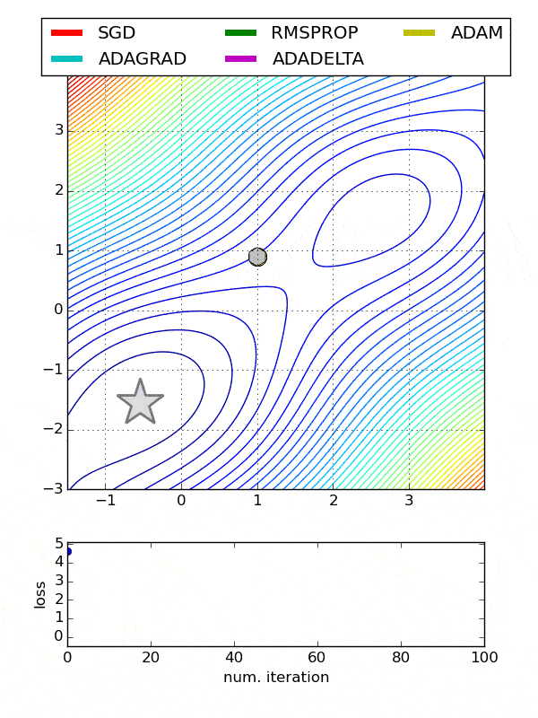
Optimizers Comparison

Slide 42
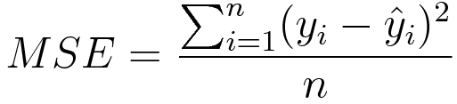
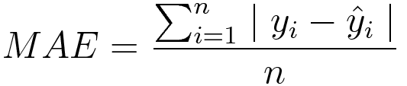
Common Loss Functions
Regression
Mean Square Error (MSE)
the average of squared difference between predictions and actual observations.
Mean Absolute Error (MAE)
the average of sum of absolute differences between predictions and actual observations.

Slide 43
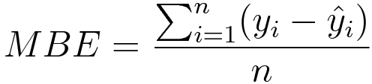
Common Loss Functions
Regression
Mean Bias Error (MBE)
same as MSE with the only difference that we don’t take absolute values.
less common.

Slide 44
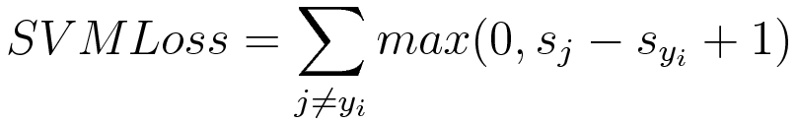
Common Loss Functions
Classification
Hinge/SVM Loss
the score of correct category should be greater than sum of scores of all incorrect categories by some safety margin (usually one).
Cross Entropy Loss
increases as the predicted probability diverges from the actual label.

Slide 45
Metrics and Fit

Slide 46
Evaluation Metrics
Confusion Matrix
Accuracy: the proportion of the total number of predictions that were correct.
Positive Predictive Value/Precision: the proportion of positive cases that were correctly identified.
Negative Predictive Value: the proportion of negative cases that were correctly identified.
Sensitivity/Recall: the proportion of actual positive cases which are correctly identified.
Specificity: the proportion of actual negative cases which are correctly identified.

Slide 47
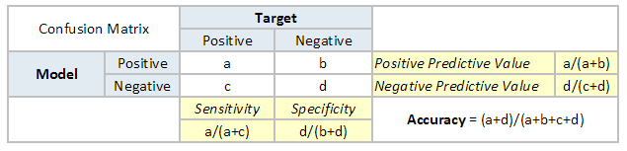
Evaluation Metrics
Confusion Matrix

Slide 48
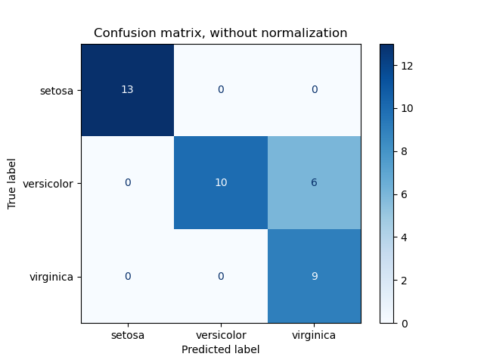
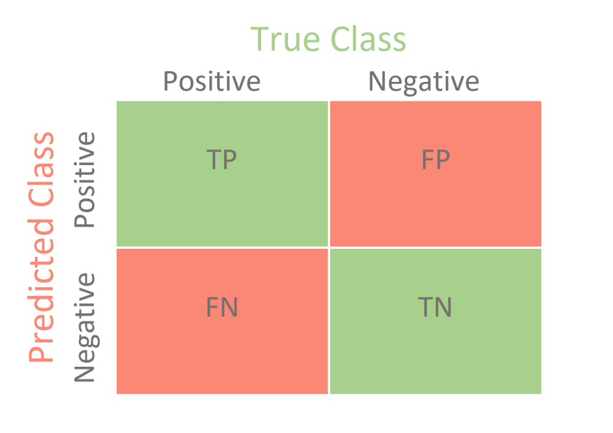
Evaluation Metrics
Confusion Matrix

Slide 49
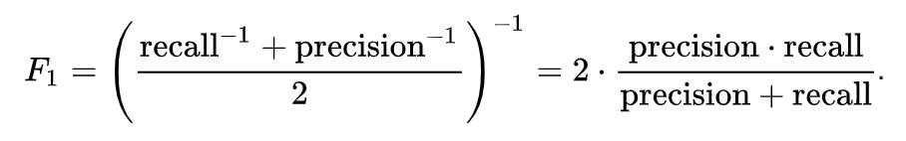
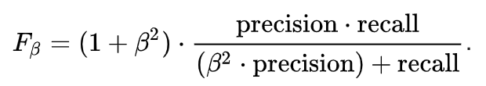
Evaluation Metrics
F1 score
Calculated using precision and recall.
Fbeta measures the effectiveness of a model with respect to a user who attaches β times as much importance to recall as precision.

Slide 50
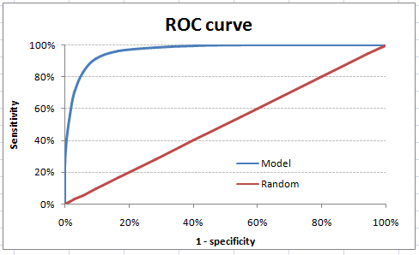
Evaluation Metrics
Area Under Curve (AUC) & Receiver Operating Characteristic (ROC)
The sensitivity and specificity varies based on confidence threshold.
The ROC curve is the plot between sensitivity and (1- specificity).

Slide 51
Evaluation Metrics
Area Under Curve (AUC) & Receiver Operating Characteristic (ROC)
AUC is the area under ROC curve.
Thumb rules:
.90-1 = excellent (A)
.80-.90 = good (B)
.70-.80 = fair (C)
.60-.70 = poor (D)
.50-.60 = fail (F)

Slide 52
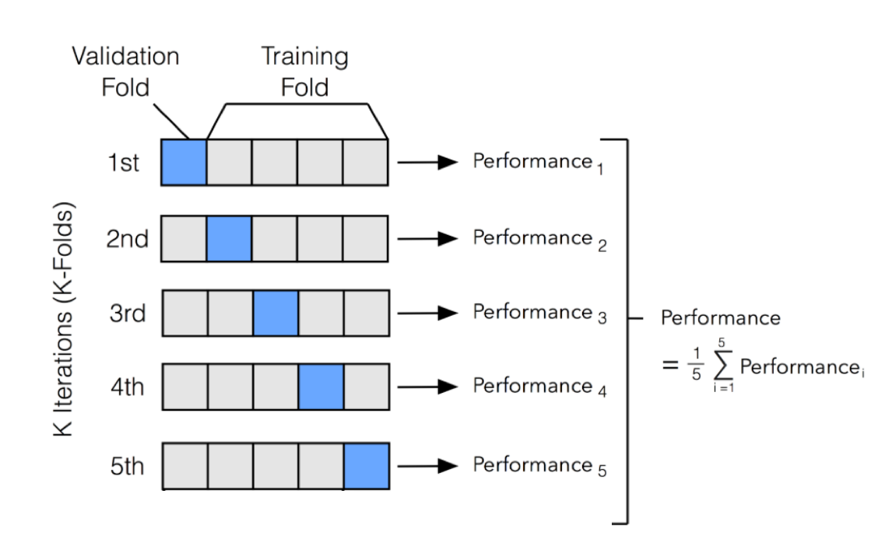
Evaluation Metrics
k-fold Cross Validation
Use different parts of dataset for each fold.

Slide 53
Evaluation Metrics
Root Mean Square Error (RMSE)
Mean Square Error (MSE)
Mean Absolute Error (MAE)

Slide 54
Goodness of Fit
Model fitting is a measure of how well a machine learning model generalizes to similar data to that on which it was trained.
Model fitting relates to bias and variance
Bias (different from bias in weights and bias): difference between the average prediction of our model and the correct value which we are trying to predict.
Variance: the variability of model prediction for a given data point or a value which tells us spread of our data.
There are 3 types of fit: underfitting, well-fit, and overfitting.
Underfitting models have low bias, high variance.
Overfitting models have high bias, low variance.
Well-fit models have low bias, low variance.

Slide 55
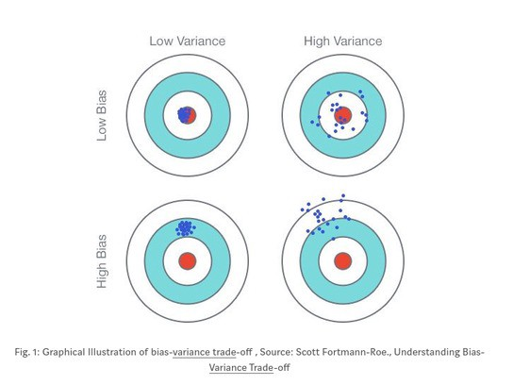
Goodness of Fit
Bias and variance illustration

Slide 56
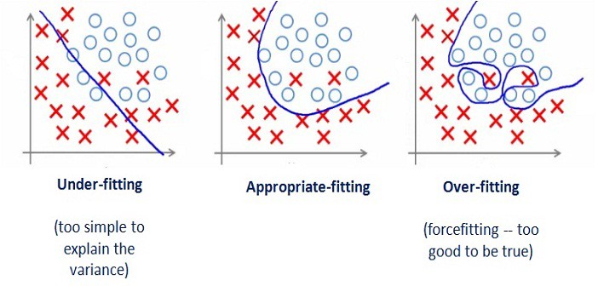
Goodness of Fit
Goodnes of fit illustration

Slide 57
Handling Underfitting
Get more training data.
Increase the size or number of parameters in the model.
Increase the complexity of the model.
Increasing the training time, until cost function is minimised.

Slide 58
Handling Overfitting
Cross-validation
Regularization
Adds penalty as model complexity increases
Early stopping
When training a learner with an iterative method, you stop the training process before the final iteration.
This prevents the model from memorizing the dataset.
Dropout
Randomly selected neurons are ignored (or “dropped”) during training.

Slide 59
ML Problems

Slide 60
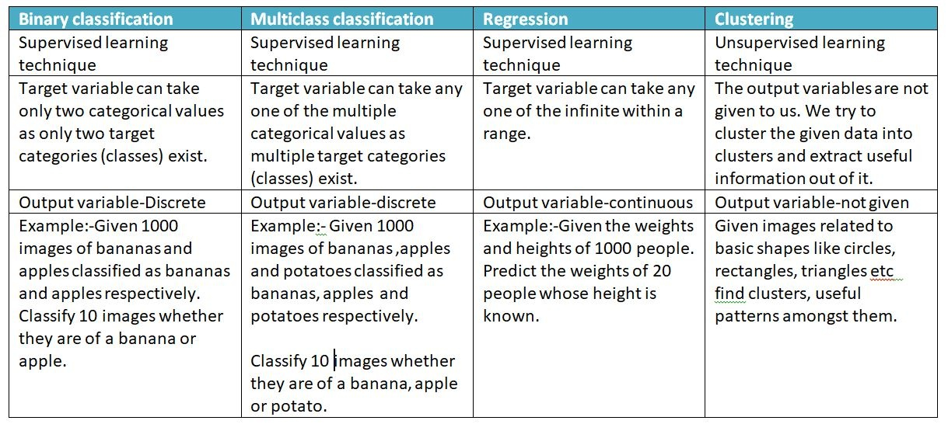
Types of ML Problems

Slide 61
Linear Regression

Slide 62
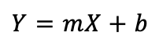
Linear Regression
Linear regression may be defined as the statistical model that analyzes the linear relationship between a dependent variable with given set of independent variables.
The dependent variable is often called the target.
The independent variable is often called the predictor.
The relationship can be represented with the help of following equation:

Slide 63
Linear Regression
Y : the dependent variable we are trying to predict
X : the independent variable we are using to make predictions
m : the slope of the regression line which represents the effect X has on Y
b : is a constant, known as the Y-intercept.

Slide 64
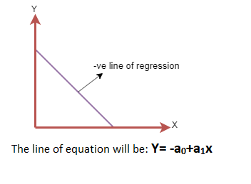
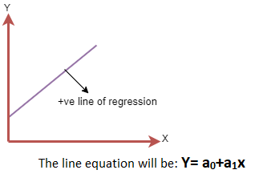
Linear Regression
Positive relationship
Negative relationship

Slide 65
Simple Linear Regression
Simple linear regression uses only one independent variable (or feature) to make prediction.
Simple linear regression uses the assumption that the two variables are linearly related.
→ go to Regression colab

Slide 66
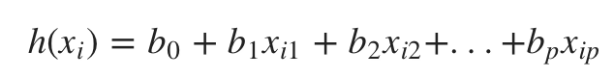
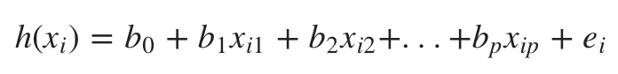
Multiple Linear Regression
Multiple linear regression uses two or more independent variable (or features) to make predictions.
Mathematical formula:
with residual error:
→ go to Regression colab

Slide 67
Assumptions in Linear Regression
Little to no multi-collinearity
Multi-collinearity occurs when the independent variables or features have dependency in them.
Little to no autocorrelation
Auto-correlation occurs when there is dependency between residual errors.
Linear relationship between variables
Linear regression model assumes that the relationship between response and feature variables must be linear.

Slide 68
Classification
Classification may be defined as the process of predicting class or category from observed values or given data points.
Unlike regression, the output variable of classification is a category, not a value.
Classification takes labeled input data, which means it contains input with the corresponding output.
Two types of classification:
Binary classification
Multiclass classification

Slide 69
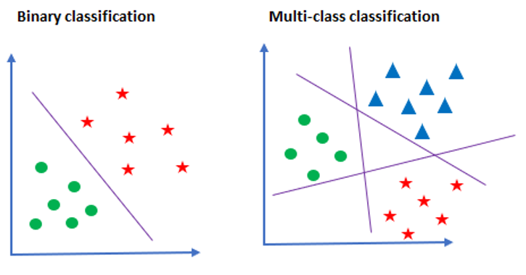
Classification

Slide 70
Logistic Regression
Supervised learning classification algorithm used to predict the probability of a target variable.
Generally, logistic regression means binary logistic regression having binary target variables.
The dependent variable is binary in nature having data coded as either 1 (stands for success/yes) or 0 (stands for failure/no).
Assumptions in logistic regression:
The target variables must be binary.
There should not be any multi-collinearity in the model.
We must include meaningful variables in our model.
We should choose a large sample size for logistic regression.
→ go to Logistic Regression colab

Slide 71
References
DeepLearning.AI TensorFlow Developer Coursera
Neural Network Design, Hagan
https://www.tutorialspoint.com/machine_learning_with_python
https://labelyourdata.com/articles/what-is-dataset-in-machine-learning
https://towardsdatascience.com/whats-the-role-of-weights-and-bias-in-a-neural-network-4cf7e9888a0f
https://www.analyticsvidhya.com/blog/2019/08/11-important-model-evaluation-error-metrics/

Slide 72
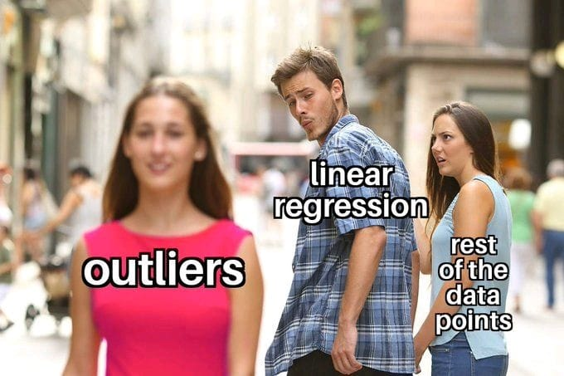
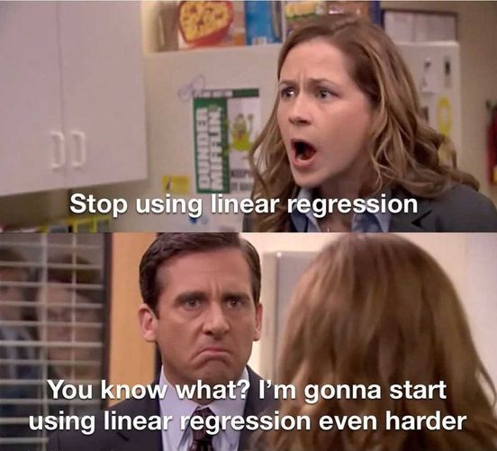

Thank You!

